Slide 1
Palm Oil Plantation Area Clusterization for Monitoring
Aufaclav Zatu Kusuma Frisky and Agus Harjoko
International Conference on Science and Technology 2016 (ICST2016)

Slide 2
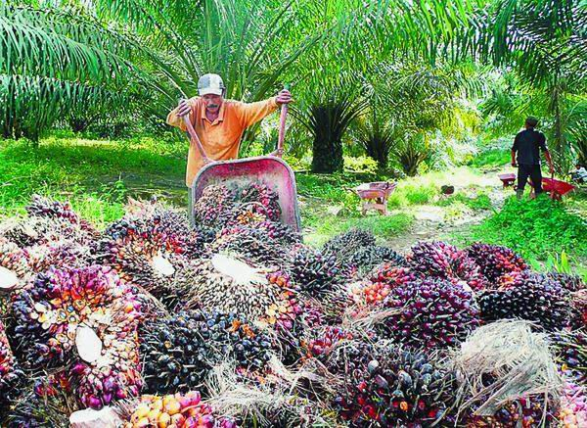
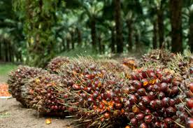
INTRODUCTION
Palm oil is a major export commodity of many countries in the world, including Indonesia.
According to the Ministry of Agriculture of the Republic of Indonesia, Indonesia has about 8 million hectares of oil palm plantations, and this number is expected to rise to 13 million hectares by 2020.

Slide 3
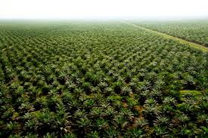
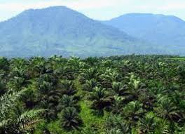
Problem
A huge area in Indonesia is dedicated to fulfilling needs for palm oil products around the globe, indicating the importance of this commodity as an export. Furthermore, it is hard to monitor all the area manually.

Slide 4
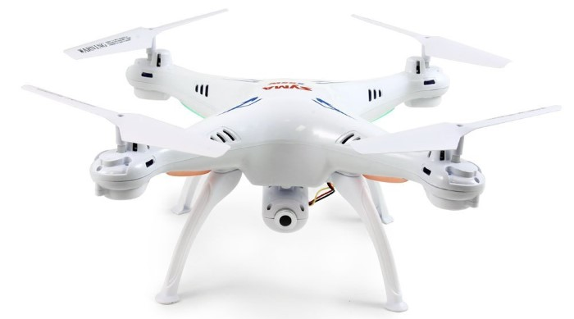
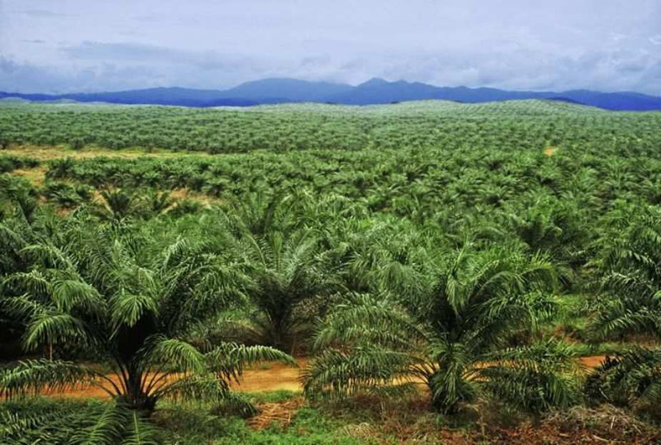
Solve

Slide 5
Related Works
Writer | Title | Feature and Classifier
Harjoko et al. (2015) | Tea Plantation Classification | Color Moments, GLCM and SVM
Gadzal et. al. | Monitor and estimate vegetation areas from UAV imagery using NDVI video and level set methods | Level Set Method
Mitchell et al. | classification of arid regions using aerial imagery | using K-Means and ISODATA

Slide 6
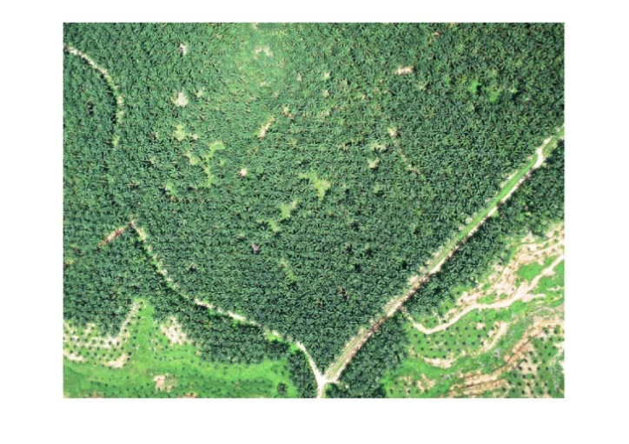
Methodology

Slide 7
Feature Extraction
Several types of color and texture feature extraction techniques were used: 2D Wavelet Decomposition Color Energy[14], PCA[15], and t-SNE[16]. Texture techniques used were Local Binary Pattern (LBP)[17], GLCM[8], and SFTA[13].

Slide 8
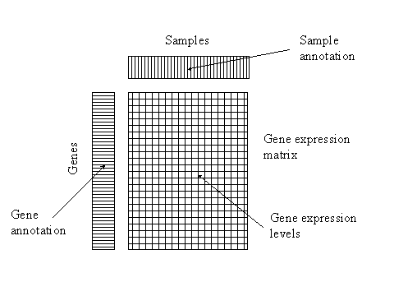
The extracted features were saved in the new matrix b x n matrix V, where b is the feature dimension and n is the number of total small patch. The number of b was varied depend on the result dimension in feature extraction

Slide 9
K-Means Clustering
In general, the algorithm to perform K-Means clustering is as follows:
1. Given matrix V=(v₁ ,v₂ ,…v_{n}), where v_{n} is the feature vector bx1 from the patch and n is the number of patch data.
2. Determine the random centroid matrix C= (c_{1,} c_{2,} … c_{k}) where c_{k} is centroid vector bx1 and k is the number of centroids.
3. Calculate the distance between each data object and all k cluster centers. The formula for calculating distance in this work is Euclidean distance, which is used for determining the nearest distance between each data objects and cluster center [18].

Slide 10
The Euclidean distance between one vector v_{n} and center vector c_{n}, the Euclidean distance d(v, c) can be obtained as follow:

Slide 11
and assign the class of vector v_{n} based on the nearest centroid. Grouping data into clusters can be done by calculating the shortest distance from a data point to a centroid.
4. Compute the mean distance in each class and update the new centroid based on the mean value using :
where is mean in k cluster and Nk is the number of data in each cluster k.

Slide 12
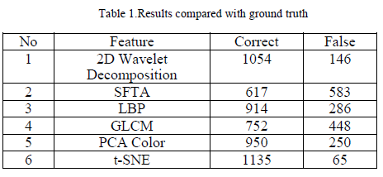
Experiment Results
Parameter :
8 thresholds for SFTA, 100 for PCA and T-SNE, 8 for neighbors, and 3 for Local Binary Pattern.

Slide 13
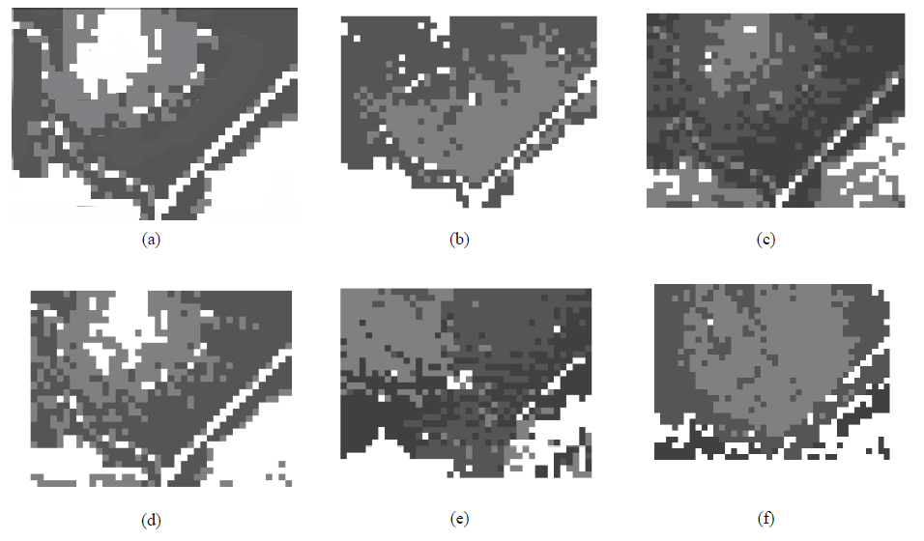

Slide 14
Results

Slide 15
Conclusion
In this paper, we conducted monitoring of a palm oil plantation using aerial images taken by UAV. Several feature extraction methods were used.
image was divided into several smaller images using sliding windows and features were extracted from each small image. Each small image was clustered, using K-Means, into three categories: healthy areas, unhealthy areas, and non-plantation areas.
Results indicate that t-SNE had the highest correct rate, with 1135 correct patches.
In the future, we hope that this system can be used to monitor different plantation areas, such as tea, coffee, and paddy fields.

Slide 16
THANK YOU

